Slide 1
Dynamic Arrays
Creative Commons Attribution-NonCommercial-ShareAlike 3.0 Unported License. http://creativecommons.org/licenses/by-nc-sa/3.0/
Written by Rachel J. Morris, last updated 2016-02-15

Slide 2

Arrays of any size!

Slide 3
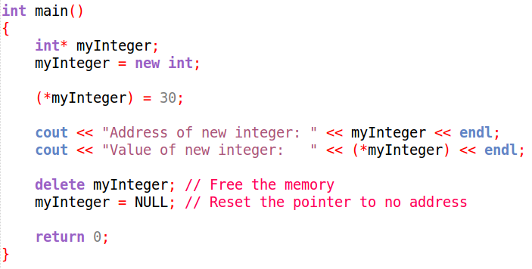
Pointers and Arrays
As we've seen in the pointer lecture, we can utilize pointers to allocate memory for new variables...

Slide 4
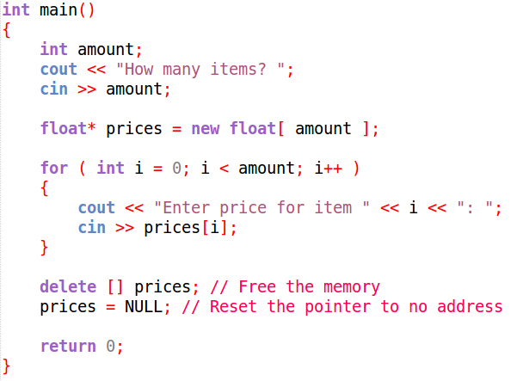
Pointers and Arrays
We can also allocate space to create an array.
Because we're allocating space at run-time,
we no longer need to know the exact size of the array at compile-time.

Slide 5


Pointers and Arrays
Static Array
(old news)
Dynamic Array
(cool new thing)
Must know size of array at compile time.
Can be set to any size!
Cannot be resized.
Can be deleted then re-created with a new size!
Even though it is more work to deal with dynamic arrays,
not being tied to a maximum value in your program can be pretty powerful!

Slide 6




Creating a dynamic array...
Step 1: Create a pointer variable
Step 2: Make a new array with
the pointer!
Step 3: Use the array like normal!
Step 4: Delete the array when you're done with it!
Step 5: Be a happy programmer

Slide 7
Finally!
Resizing our arrays!

Slide 8
Resizing arrays
Resizing a dynamic array isn't as simple as adding on to the end of it, unfortunately.
(we will write data structures later on more like this!)
In order to resize an array, we essentially have to :
(1) make a new, bigger array,
(2) copy the contents of our array over,
(3) delete the old small array
(4) set the pointer to point to the new bigger array.

Slide 9
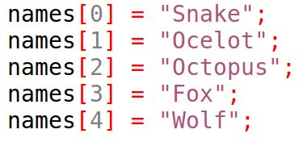
Resizing arrays
So, let's say we created an array...
...But it filled up quickly.
Now we need more space!

Slide 10
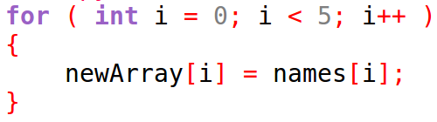
Resizing arrays
We need to create a new array with more space!
And we need to copy the values from the smaller array into the larger array!

Slide 11



Resizing arrays
We don't need the small array anymore, so let's free that memory.
But, we still want to keep using the variable name names.
We don't want to use the variable name newArray!
No problem, let's set the names pointer to point to the bigger array!
No more use for newArray, so let's reset it to NULL!

Slide 12
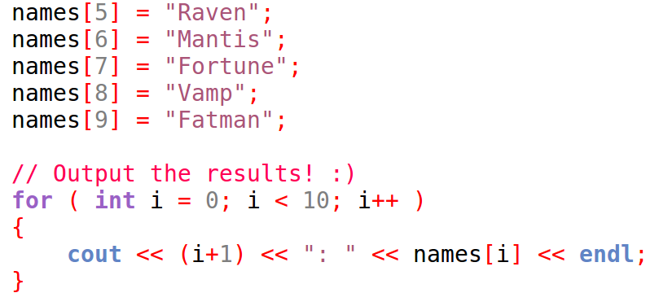
Resizing arrays
Now we can keep using our names array!
...Any everybody lived happily ever after.
And don't forget to free any allocated memory at the end of the program!!

Slide 13

Too much to remember?
No problem!

Slide 14

Lightening the Load
Q: What is the point of programming?
A: To automate tasks so we don't have to waste our time on it!!

Slide 15
Lightening the Load
Don't want to keep track of new and delete?
Don't want to keep rewriting resizing logic any time you need a bigger array?
Write a class to “wrap” it all up for you!!

Slide 16
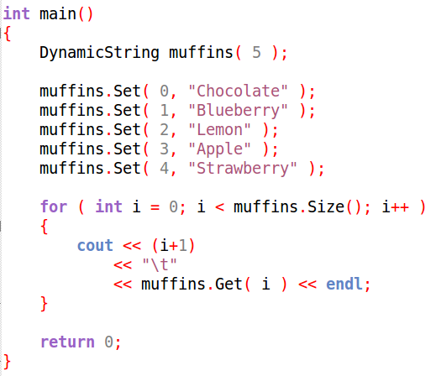
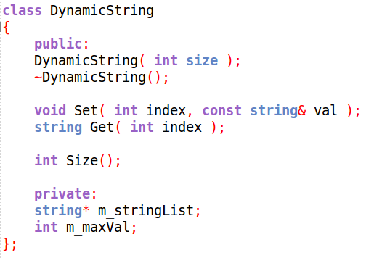
Lightening the Load
Through the magic of classes, you can put everything you need to deal with dynamic arrays in one class!

Slide 17
Sample Code
Let's work with some dynamic arrays to get a feel for 'em!
And we'll make this special wrapper class to deal with
Memory Allocation for us!

Slide 18
Sample Programs...
A. Simple Dynamic Array
B. Resizing an Array
C. Array Wrapper Class

Slide 19
Sample Programs...
A. Simple Dynamic Array
B. Resizing an Array
C. Array Wrapper Class

Slide 20
Sample Programs...
A. Simple Dynamic Array
B. Resizing an Array
C. Array Wrapper Class

Slide 21
Sample Programs...
A. Simple Dynamic Array
B. Resizing an Array
C. Array Wrapper Class

